Slide 1
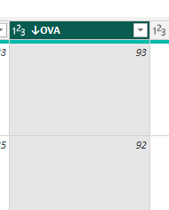
Convert to percentage
Divide 100 .
Change data type ova,pot,bov

Slide 2
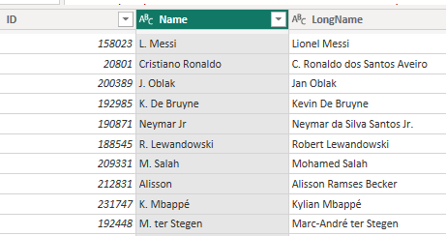
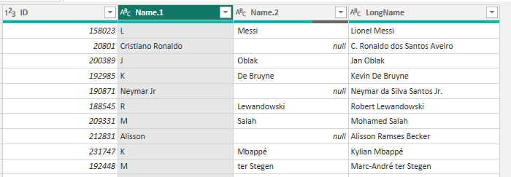
Split by delimeter space
Then replace . By nothing
Get length

Slide 3
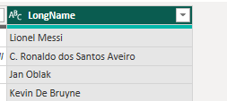
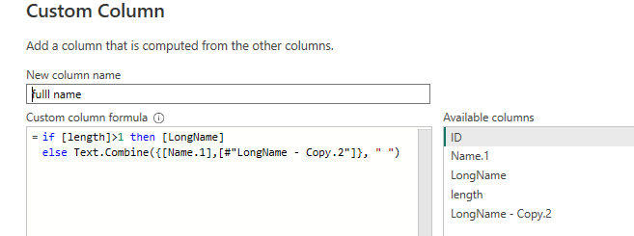
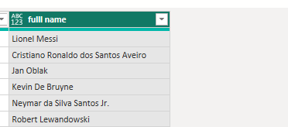
Duplicate long name split that column
In long name copy 1 == remove the . Replace the dot to nothing
Get the length -- rename
Remove name.2
Remove other rows and create a first name and last name columns

Slide 4
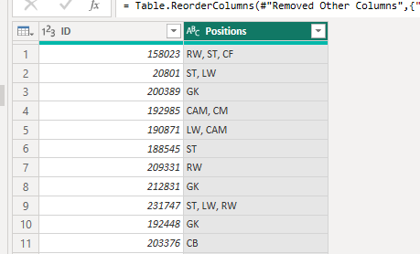
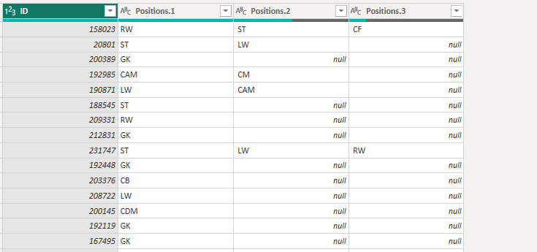
Separete postions

Slide 5
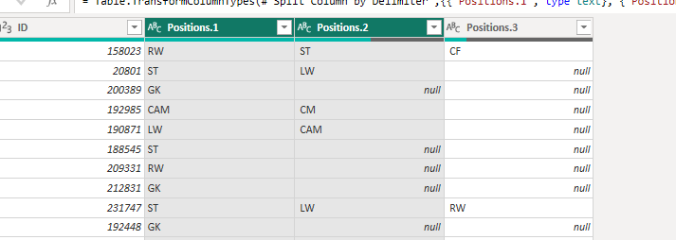
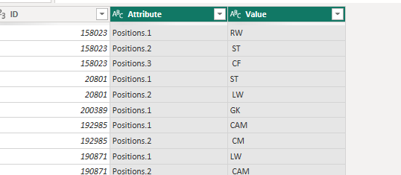
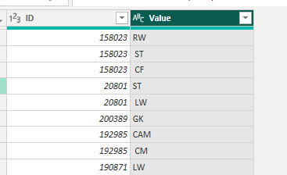
UNPIVOT COLUMNS
FILTER THE ID
REMOVE ATTRIBUTE
SELECT 3 COLUMNS UNPIVOT

Slide 6
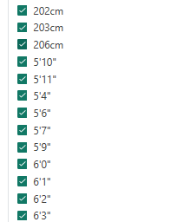
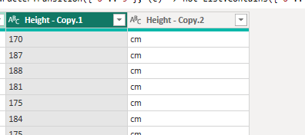
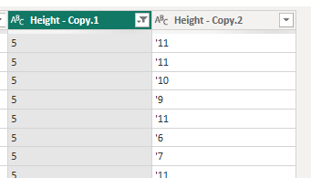
Duplicate heig
Split by digit not digit
Remove the first char apostrophe
Split column

Slide 7
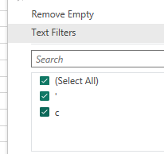
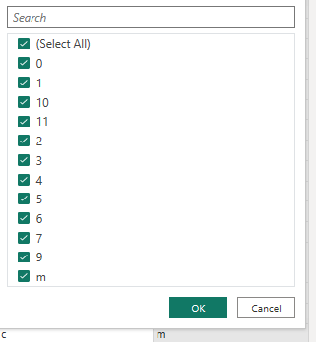
Replace m as true

Slide 8
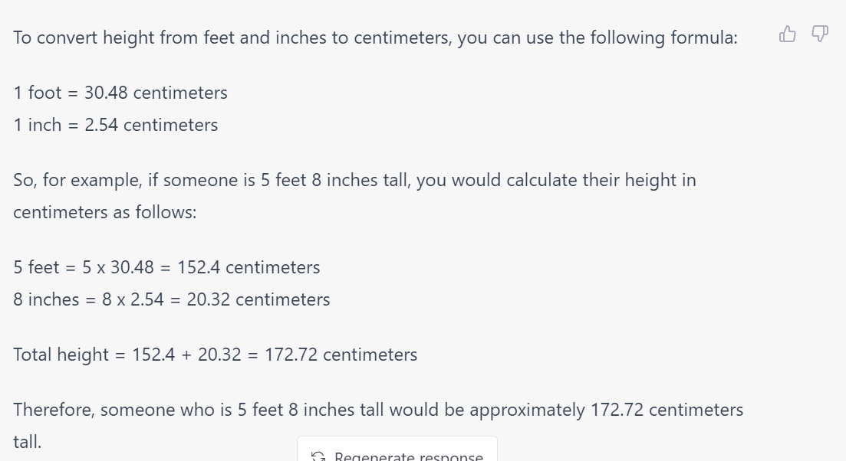

Slide 9
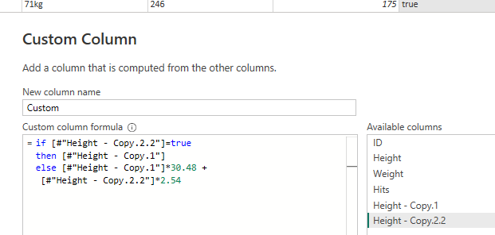
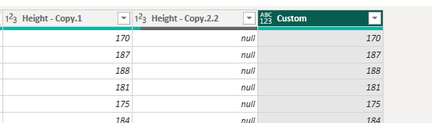
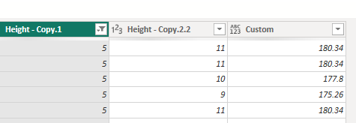
M to null
Convert height copy 2.2. to number

Slide 10
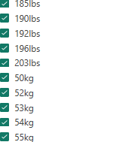
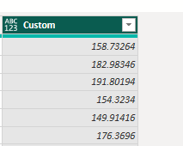
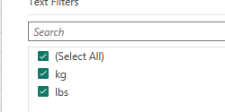
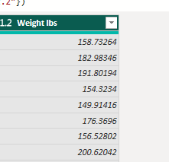
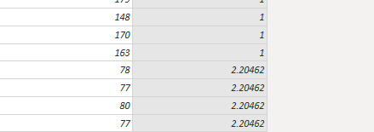

Split by digit non digit
Results in two columns
Convert wight 1 to number
Replace kg by 2.20462
Lbs by 1
Muliptly columns
Convert to decimal rename

Slide 11
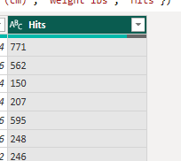
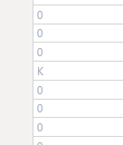
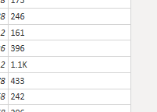
Duplitcate hits
Get length
Column from example
0 for no k
K for thousands
Replace K by 1000
Replace k in hits
By nothing
Multipy
Convert to numbers

Slide 12
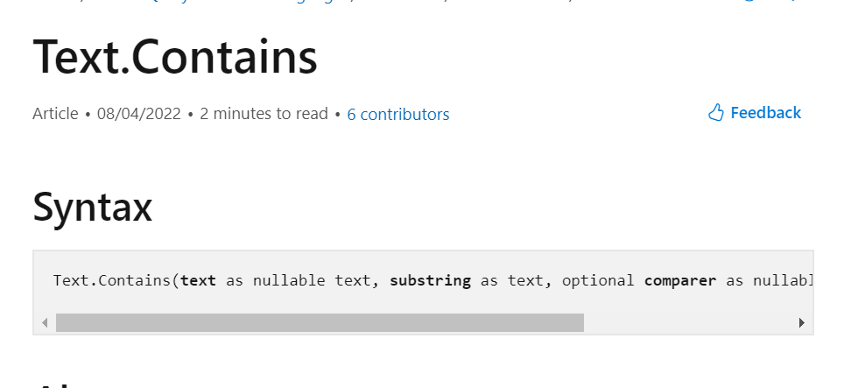

Slide 13
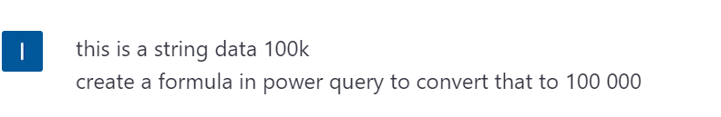
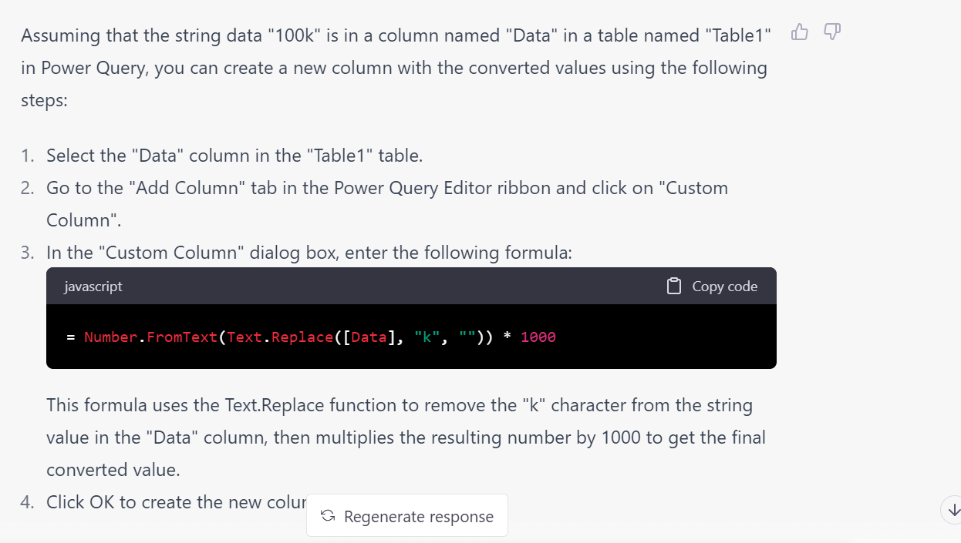

Slide 14
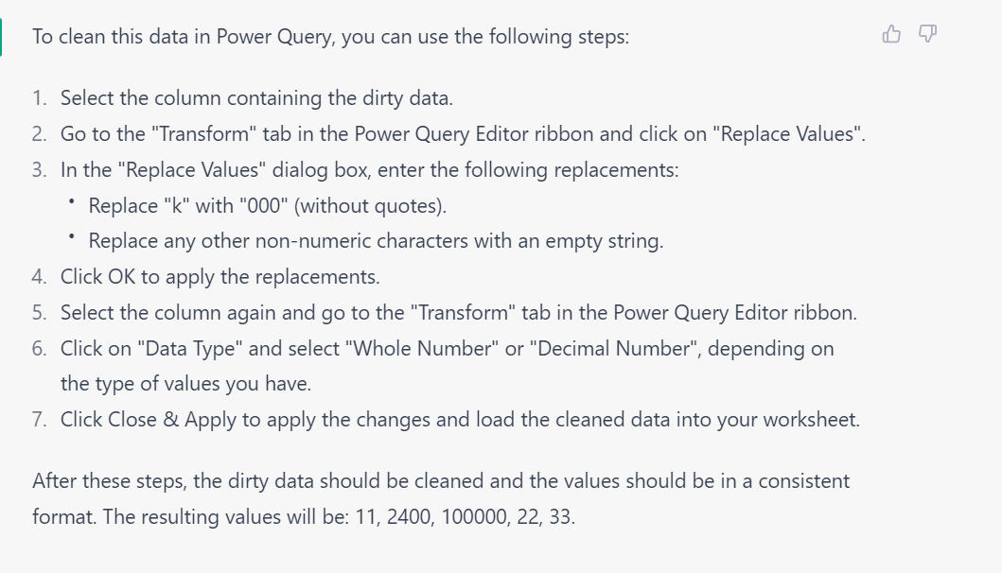
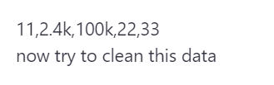

Slide 15
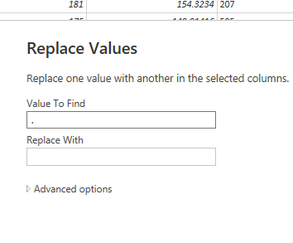
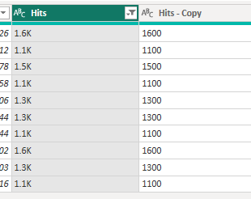
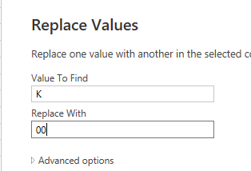
Duplicate to check

Slide 16
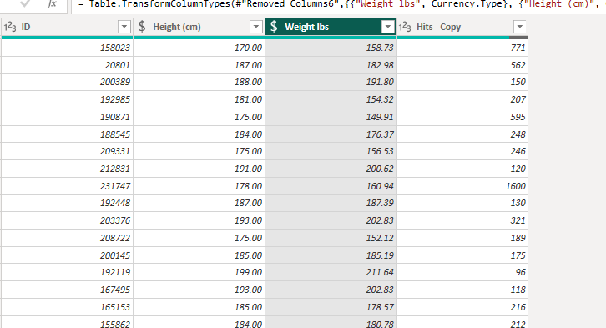

Slide 17
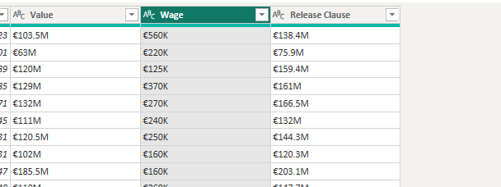

Slide 18
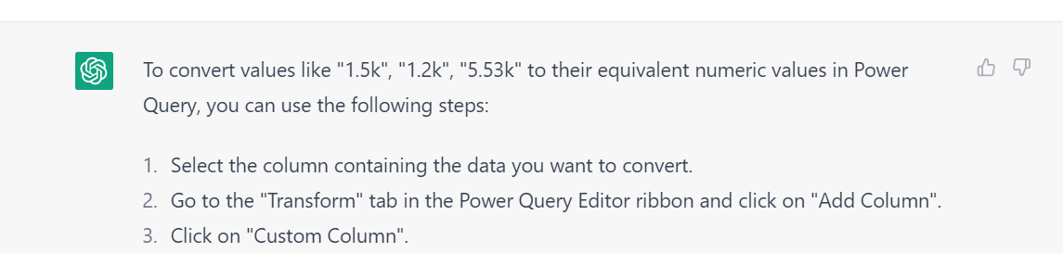
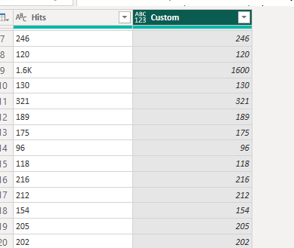

Slide 19
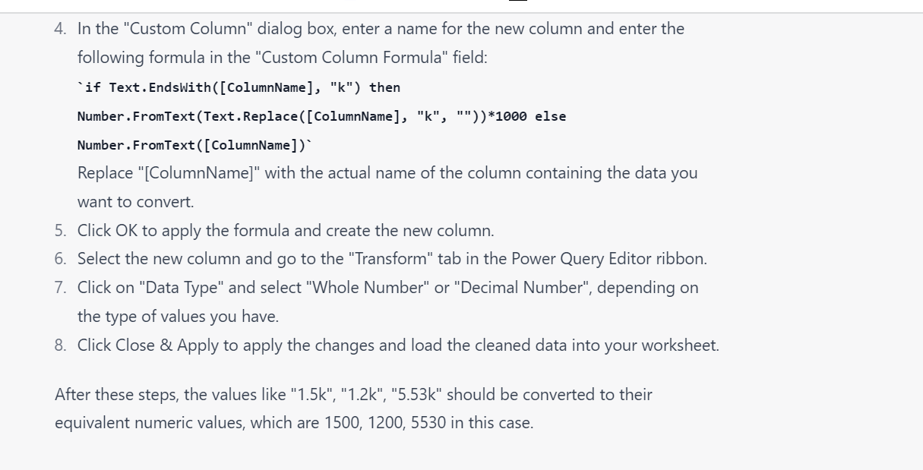

Slide 20
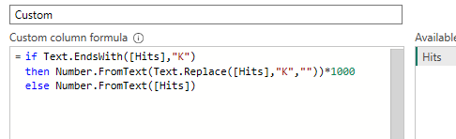
If “K” texts ends in K (string thousands)
Then replace K with “ ”
2.6 k to 2.6
Then convert that to a number
2.6
And multiply by 1000
Else
Just convert it to a number
if Text.EndsWith([Hits],"K")
then Number.FromText(Text.Replace([Hits],"K",""))*1000
else Number.FromText([Hits])

Slide 21
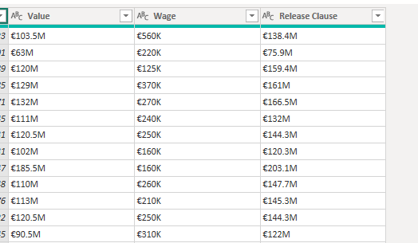
Same with text ends with
Split by number of characters

Slide 22
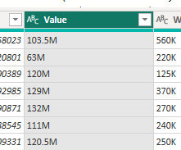
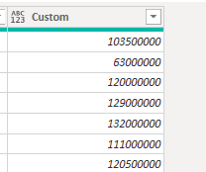
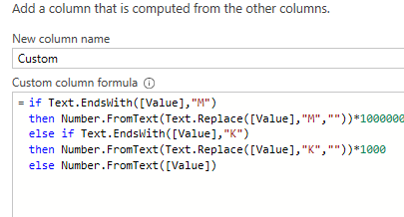
if Text.EndsWith([Value],"M")
then Number.FromText(Text.Replace([Value],"M",""))*1000000
else if Text.EndsWith([Value],"K")
then Number.FromText(Text.Replace([Value],"K",""))*1000
else Number.FromText([Value])
Nested if
If text end with M multiply by million
Ends with K
Multipy by 1000
Last just convert to number

Slide 23
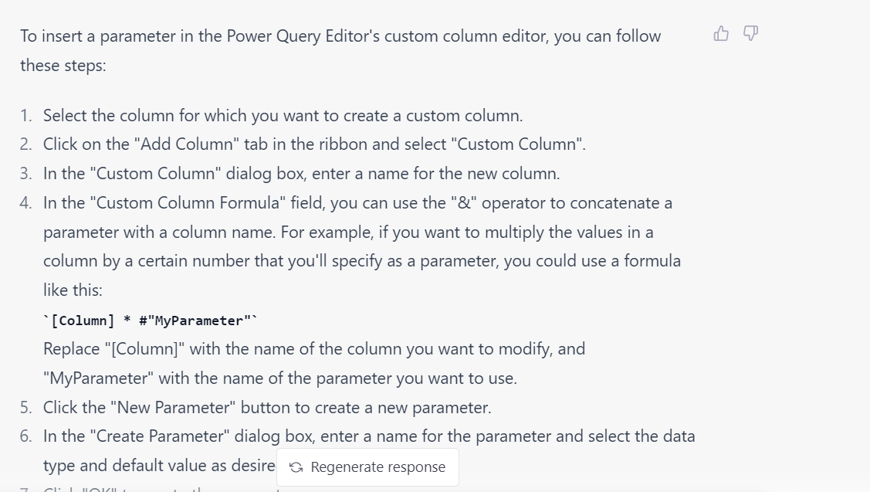

Slide 24
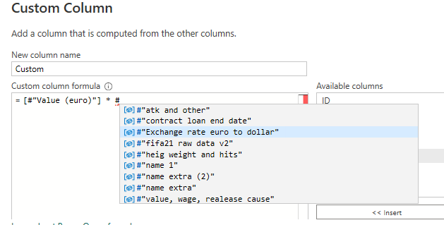

Slide 25
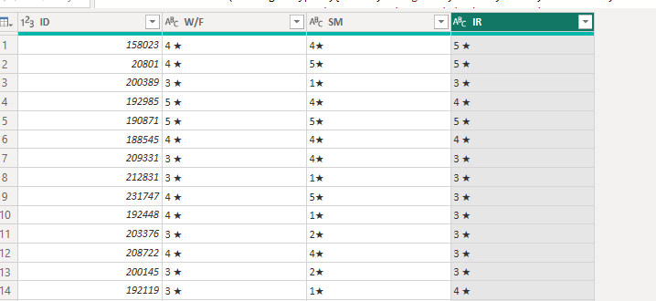
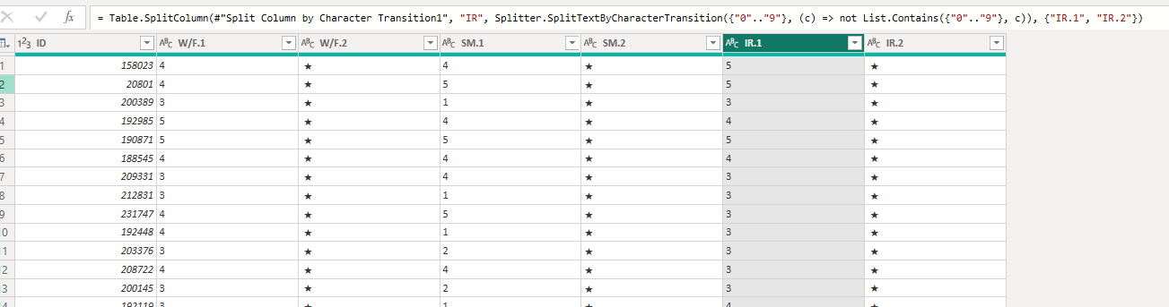

Slide 26



Split to 3 tables
Contract
On loan
free
Clean
Split by delimeter space
Rename contract start
Contract end

